Slide 1
When code
it’s not enough.

Slide 2
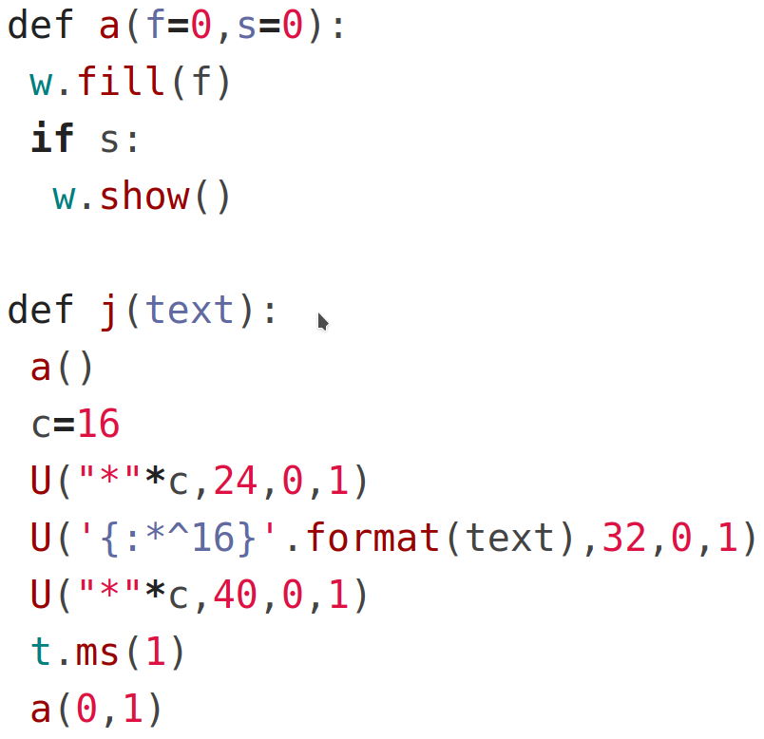
“the code is right there, just read it.”

Slide 3
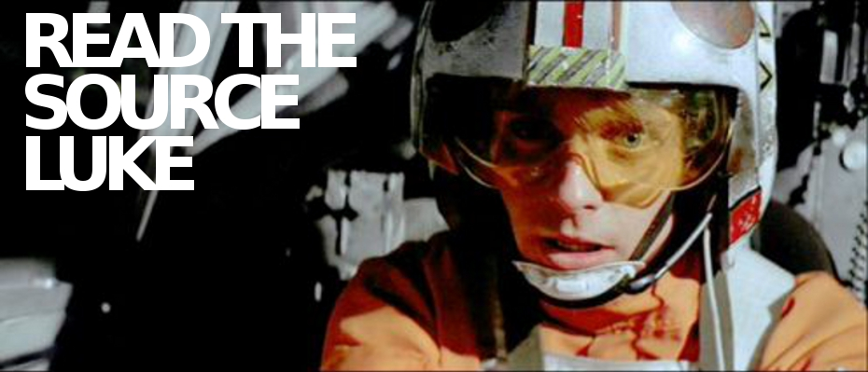

Slide 4
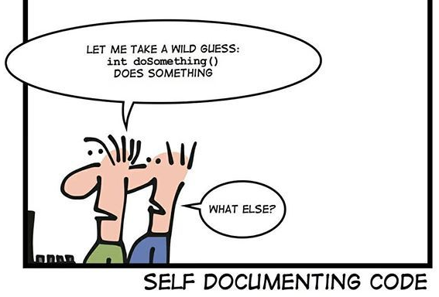
“Good code documents itself”

Slide 5
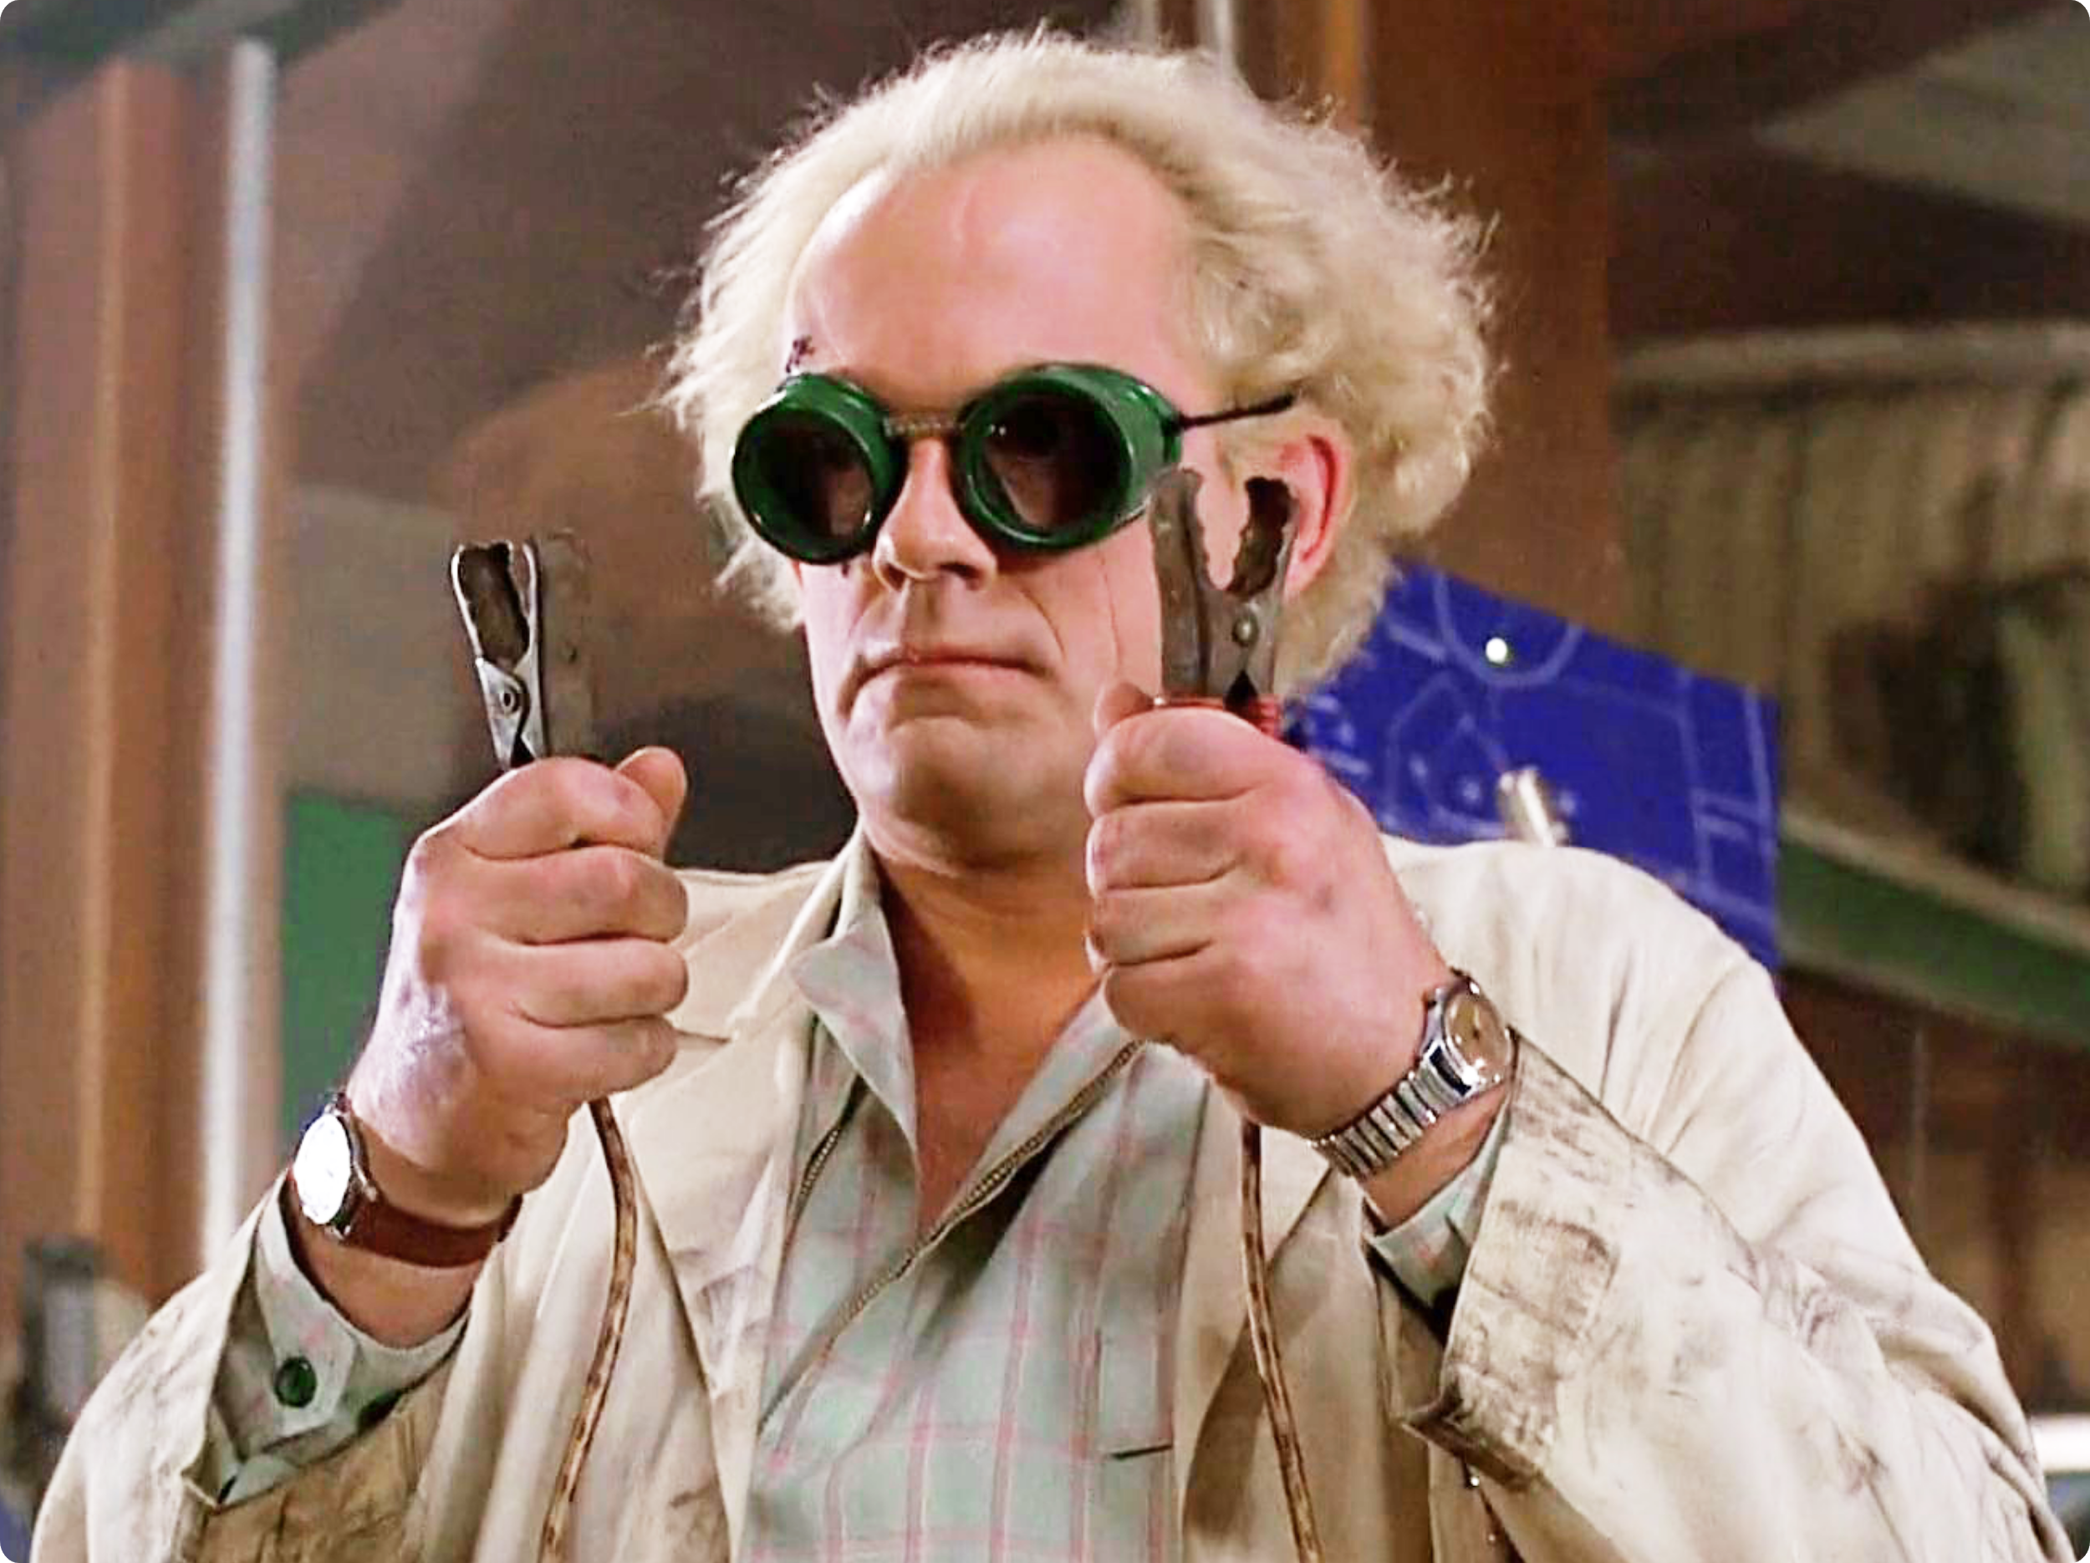
Juan Biondi
Python software developer at ERNI Consulting.
Open source 💓 & contributor.
Kind of maker.

Slide 6
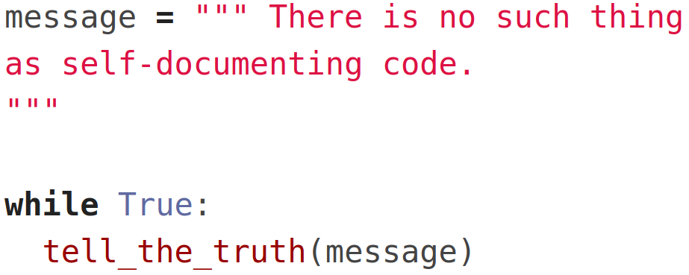

Slide 7
“Code is read more often than it is written”
Guido Van Rossum
Python Enhancement Proposal 8 (PEP8)

Slide 8
What is it good code?

Slide 9
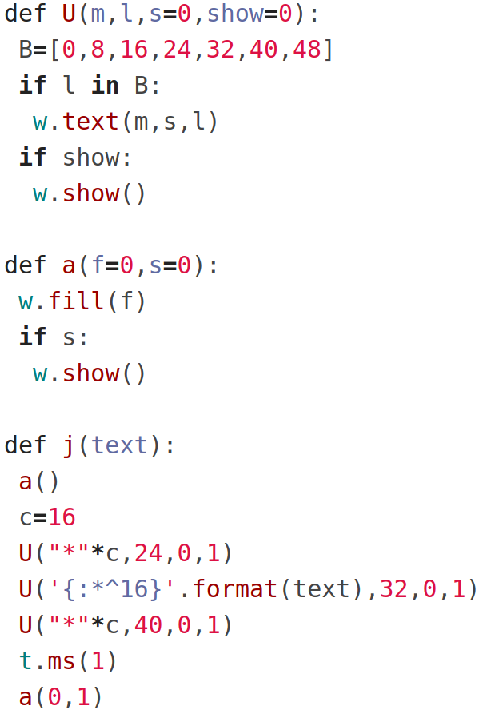

Slide 10
What is
clean code?

Slide 11
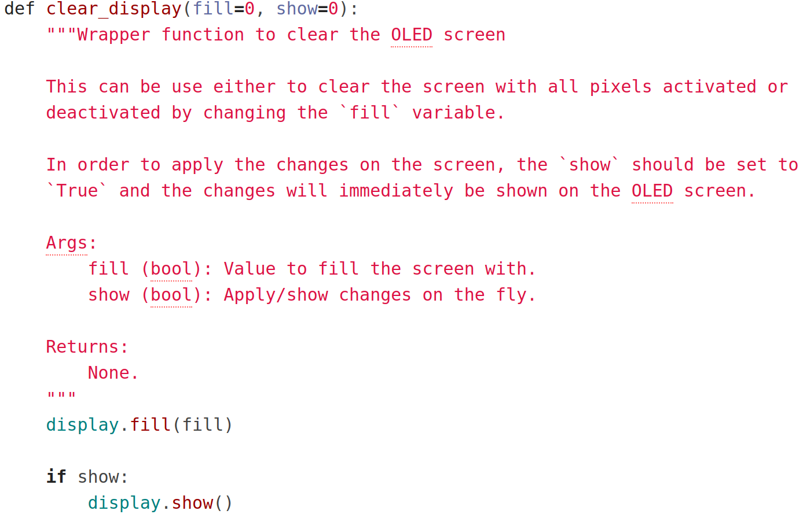

Slide 12
Some advice

Slide 13
Read
PEP-8
PEP-257
PEP-484
Use easy and common names.
Separate conditionals and loops by a blank line.
Use type hint as much as possible.
Document classes, functions and important code statements.
Lint your code with some tools.

Slide 14
Bad news

Slide 15
“Documentation should also be maintained.”

Slide 16
Thanks!

